Slide 1
CSE 470 : Software Engineering
The Software Process

Slide 2
What is a Process?
We can think of a series of activities as a process
Any process has the following characteristics
  It prescribes all of the major activities
  It uses resources and produces intermediate and final products
  It may include sub-processes and has entry and exit criteria
  The activities are organized in a sequence
  Constraints or control may apply to activities
  (budget control, availability of resources )

Slide 3
The Software Process
A structured set of activities required to develop a software system
  Specification
  Analysis, design and implementation
  Validation
  Evolution
A software process model is an abstract representation of a process
  It presents a description of a process from some particular perspective

Slide 4
Software Development Approaches
Generic Software Process Models
  The waterfall model (Linear Sequential Model)
    Separate and distinct phases of specification and development
  Evolutionary development
    Specification, development and testing are interleaved
Formal systems development (example - ASML)
  A mathematical system model is formally transformed to an implementation
ASML - Abstract State Machine Language
Yuri. Gurevich, Microsoft Research, 2001

Slide 5
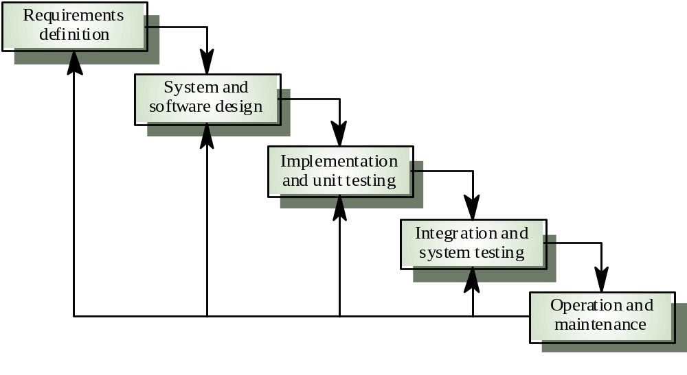
Waterfall Model

Slide 6
Waterfall model phases
Requirements analysis and definition
System and software design
Implementation and unit testing
Integration and system testing
Operation and maintenance
The drawback of the waterfall model is the difficulty of accommodating change after the process is underway

Slide 7
Waterfall model Requirement and Design
Artifacts produced in the requirements and Design phases
SRS -Software Requirements specification document
SRS might include:
  User usage stories (scenarios) – Use cases.
  Static analysis – class diagrams.
  Behavioural analysis – sequence diagrams, state charts.
The specification and design activities are heavily time consuming.

Slide 8
The requirements document
The requirements document is the official statement of what is required of the system developers.
Should include both a definition of user requirements and a specification of the system requirements.
It is NOT a design document. As far as possible, it should set of WHAT the system should do rather than HOW it should do it

Slide 9
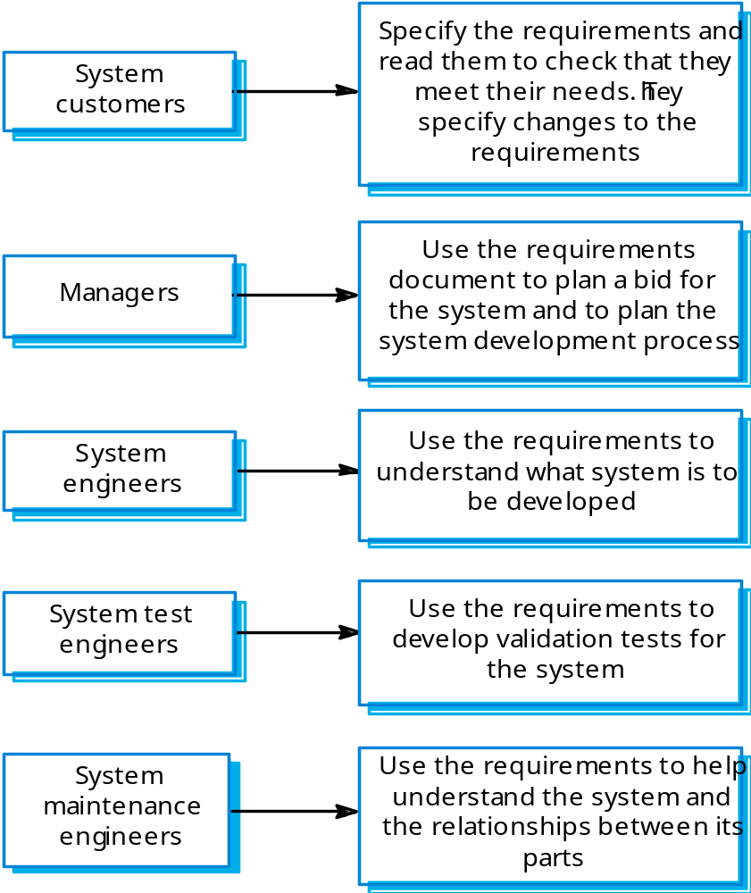
Users of a requirements document

Slide 10
The Waterfall process characterization:
Figure out what
Figure out how
Then do it
Verify was done right
Hand product to customer
Perfect requirement definition?
Notes:
It is hard to come up with a perfect requirements definition.
It was common to discover in the design phase that the requirements were not consistent or that a small change in the requirements would lead to a system that was both easier to design and more useful for the customer, but the analysis phase was over, so the designers had no choice – they had to take the existing requirements errors and all.
This problem would repeat itself during implementation.
The deisgners thought they knew how to solve the problem as efficiently as possible, but when the design was actually implemented, it turned out tha the resulting program was not as fast as the designers had thought.
The next transition is one with which you are surely familiar.
When the prrogram was handed to the quality assurance department for testing, many bugs were found that would best be fixed by reimplementing, or manybe even redesigning the program, but the waterfall model did not allow for this.
Finally, when the customers received the finished product, they wre often not at all happy with it. Even though the customers were typically very involved in the analysis phase, often they themselves were not sure exactly what they needed. After all, it can be difficult to describe how you want to use a product that you have never seen before. But when the customers stateed using the program, they began to realise what they would have liked. Of course, then it was too late, and they had to live with what they got.
Having some level of iteration is clearly necessary. There simply muyst be a mechanism to deal with errors from the preceding phase.

Slide 11
Waterfall model problems
Inflexible partitioning of the project into distinct stages
Difficult to respond to changing customer requirements
This model is only appropriate when the requirements are well-understood
Waterfall model describes a staged development process
    Change during development is unlikely
    Widely used in large systems: military and aerospace industries

Slide 12
Why Not a Waterfall
No fabrication step
  Program code is another design level
  Hence, no “commit” step – software can always be changed…!
No body of experience for design analysis (yet)
  Most analysis (testing) is done on program code
  Hence, problems not detected until late in the process
Waterfall model takes a static view of requirements
  Ignore changing needs
  Lack of user involvement once specification is written
Unrealistic separation of specification from the design
Doesn’t accommodate prototyping, reuse, etc.

Slide 13
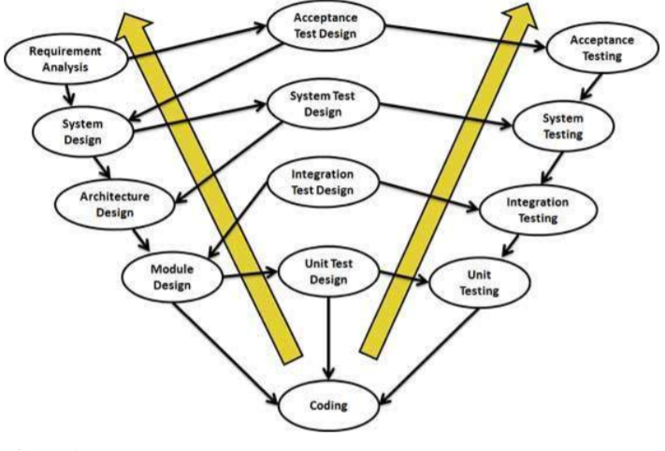
V-Model
The V - model is SDLC model where execution of processes happens in a sequential manner in V-shape. It is also known as Verification and Validation model.
V - Model is an extension of the waterfall model and is based on association of a testing phase for each corresponding development stage. This means that for every single phase in the development cycle there is a directly associated testing phase. This is a highly disciplined model and next phase starts only after completion of the previous phase.
Under V-Model, the corresponding testing phase of the development phase is planned in parallel. So there are Verification phases on one side of the .V. and Validation phases on the other side. Coding phase joins the two sides of the V-Model.

Slide 14
V-Model (cont.)
Verification Phases
  Do we build the product right?
Coding
Validation Phases
  Do we build the right product?

Slide 15
VALIDATION
VERIFICATION

Slide 16
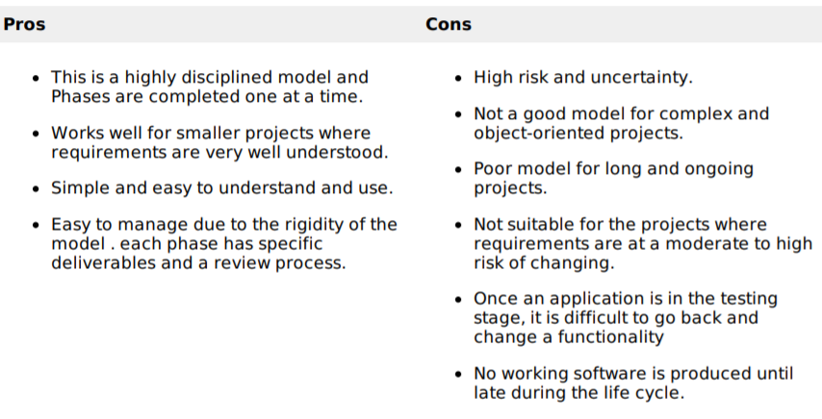
V-Model (cont.)

Slide 17
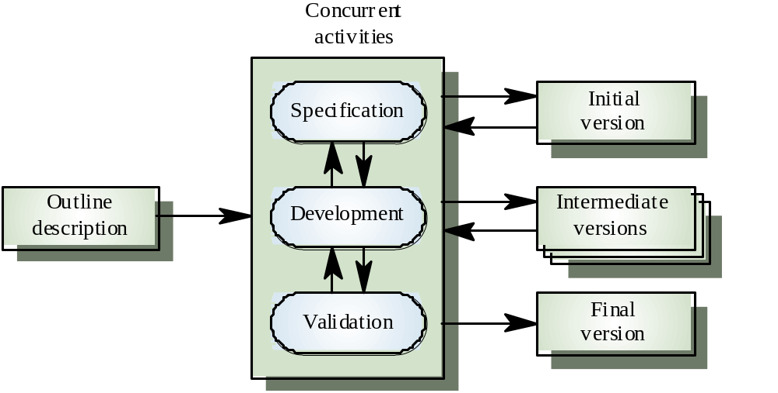
Evolutionary development

Slide 18
Characteristics of Evolutionary Development
Modern development processes take evolution as fundamental, and try to provide ways of managing, rather than ignoring, the risk.
System requirements always evolve in the course of a project.
Specification is evolved in conjunction with the software – No complete specification in the system development contract. Difficult for large customers.
Two (related) process models:
  Incremental development
  Spiral development

Slide 19
Incremental Development
Rather than deliver the system as a single delivery, the development and delivery is broken down into increments with each increment delivering part of the required functionality.
User requirements are prioritised and the highest priority requirements are included in early increments.
Once the development of an increment is started, the requirements are frozen though requirements for later increments can continue to evolve.

Slide 20
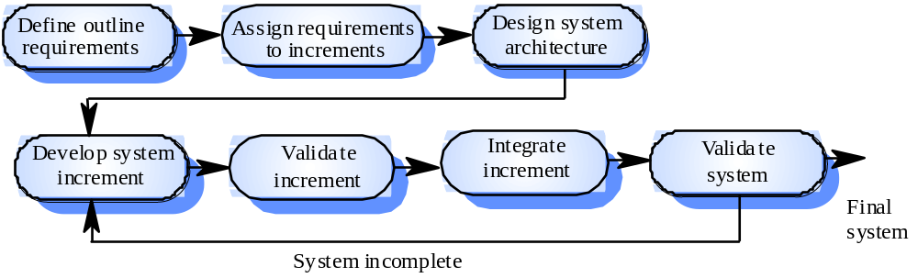
Incremental Development – Version I

Slide 21
Incremental Development –Advantages
Customer value can be delivered with each increment so system functionality is available earlier.
Early increments act as a prototype to help elicit requirements for later increments.
Lower risk of overall project failure.
The highest priority system services
tend to receive the most testing.

Slide 22
Incremental Development – Problems
Lack of process visibility.
Systems are often poorly structured.
Applicability claims in the literature:
  For small or medium-size interactive systems.
  For parts of large systems (e.g. the user interface).
  Hardware or man power resources are limited.

Slide 23
Incremental means adding, iterative means reworking (by Alistair Cockburn)
Incremental development is a staging and scheduling strategy in which the various parts of the system are developed at different times or rates and integrated as they are completed. The alternative is to develop the entire system with a big bang integration at the end.
Iterative development is a rework scheduling strategy in which time is set aside to revise and improve parts of the system. The alternative development is to get it right the first time (or at least declare that it is right!).
Iterate | Increment
fundamentally means “change”. | fundamentally means “add onto”.
repeating the process on the same section of work | repeating the process on a new section of work.
repeat the process (, design, implement, evaluate), | repeat the process (, design, implement, evaluate),

Slide 24
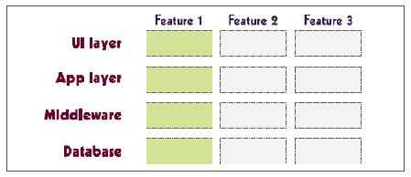
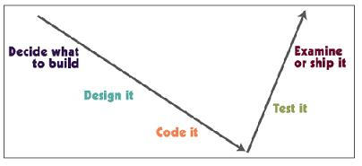
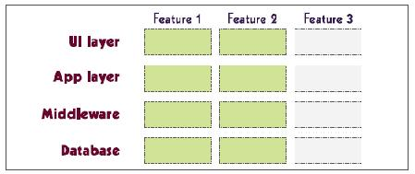
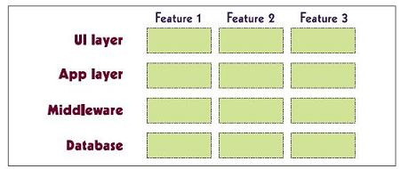
Incremental Development
The first increment delivers one slice of
functionality through the whole system.
The second increment delivers another
slice of functionality through the whole system.
The third increment delivers the rest of
the system

Slide 25
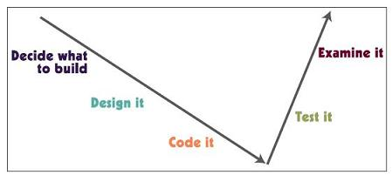
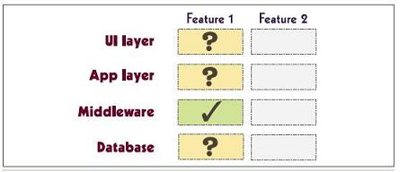
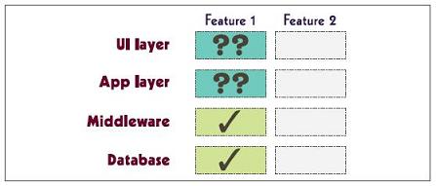
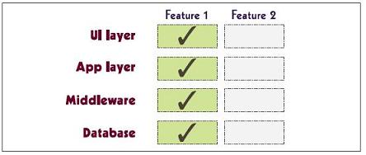
Iterative Development
The first iteration delivers enough of
feature 1 to evaluate what is correct
and what needs revision.
After the second iteration, some revised
parts still need improvement.
The third iteration produces the final
and stable feature

Slide 26
Iterative Development – Prototyping Model
Sometimes user don’t know the requirement clearly.
May be confused about the efficiency of an algorithm, the adaptability of an operating system, or the form that human-machine interaction should take.
The delivered product is a prototype initially (not a running product).
Ideally, the prototype serves as a mechanism for identifying software requirements

Slide 27
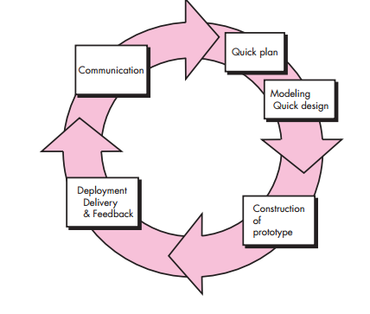
Iterative Development – Prototyping Model

Slide 28
Iterative Development – Prototyping Model
Disadvantages:
  The stakeholders see the ready product, and don’t know it has been created haphazardly by gluing several resources to deliver asap.
  Using inefficient approaches seem normal, and long lasts in the system code.

Slide 29
Spiral Model
The spiral model is a risk-driven process model generator for software projects. Based on the unique risk patterns of a given project, the spiral model guides a team to adopt elements of one or more process models, such as incremental, waterfall, or evolutionary prototyping.
This model was first described by Barry Boehm in his 1986 paper "A Spiral Model of Software Development and Enhancement".
Notes:
Spiral is a type if iterative model. Spiral is combination of waterfall and iterative. Each iteration or spiral in spiral model is waterfall. In iterative the number n is not defined, true for spiral as well.

Slide 30
Spiral development
Process is represented as a spiral rather than as a sequence of activities with backtracking.
Each loop in the spiral represents a phase in the process.
No fixed phases such as specification or design – loops in the spiral are chosen depending on what is required.
Risks are explicitly assessed and resolved throughout the process.

Slide 31
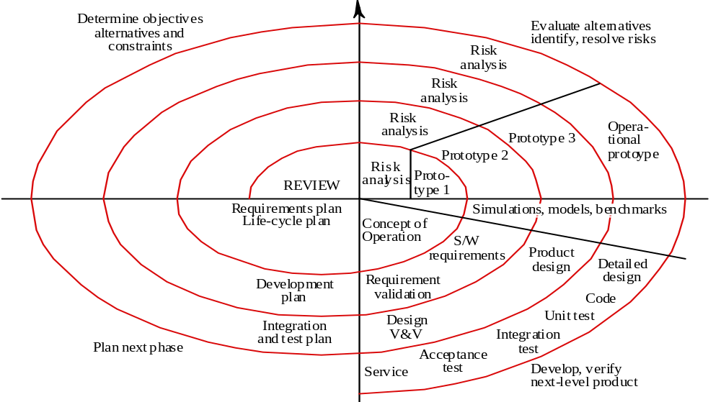
Spiral model of the software process

Slide 32
Spiral model sectors
Objective setting
• Specific objectives for the phase are identified
Risk assessment and reduction
• Risks are assessed and activities put in place to reduce key risks
Development and validation
• A development model for the system is chosen which can be any of the generic models
Planning
• The project is reviewed and next phase of the spiral is planned

Slide 33
Spiral model usage
Spiral model has been very influential in helping people think about iteration in software processes and introducing the risk-driven approach to development.
In practice, however, the model is rarely used as published for practical software development.

Slide 34
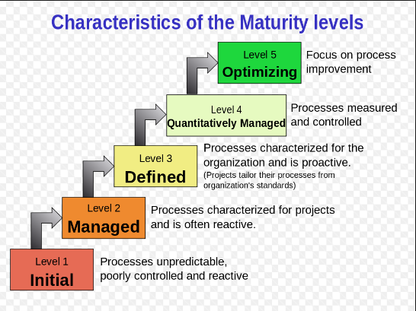
CMMI: Capability Maturity Models Integrated

Slide 35
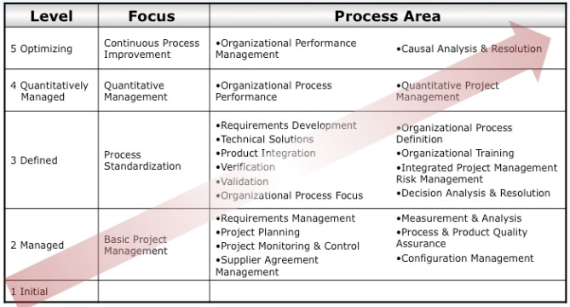
CMMI: Capability Maturity Models Integrated (cont.)

Slide 36
Summary
Iterative model - This model iterates requirements, design, build and test phases again and again for each requirement and builds up a system iteratively till the system is completely build.
Incremental model - It is non integrated development model. This model divides work in chunks and one team can work on many chunks. It is more flexible.
Spiral model - This model uses series of prototypes in stages, the development ends when the prototypes are developed into functional system. It is flexible model and used for large and complicated projects.
Evolutionary model - It is more customer focused model. In this model the software is divided in small units which is delivered earlier to the customers.
V-Model - It is more focused on testing. For every phase some testing activity are done.

